Slide 1
BIN420 - Assembly
Arturo Vera Ponce de Leon

Slide 2
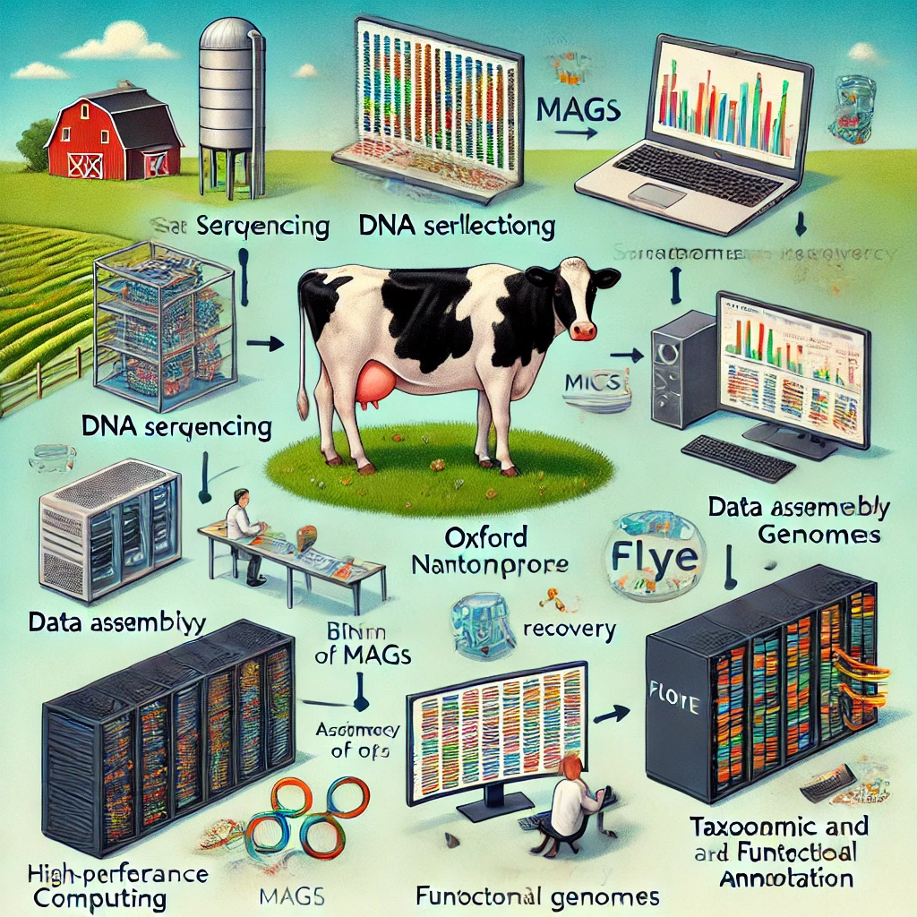
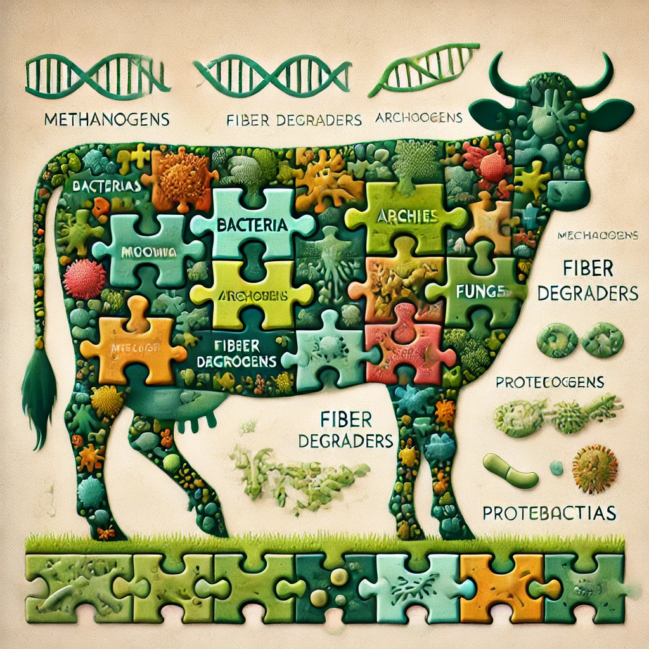
The omics give a faceted view of biology
1
Norwegian University of Life Sciences

Slide 3




Sequencing machines
Read length, bp | 100-300 | 200-400 | 1000-70000 | 5000-900000
Error rate | 0.1-1% | 1-2% | 10-20% | 10-20%
Error type | Mismatches only | Indels & Mismatches | Indels & Mismatches | Indels & Mismatches
Comments | Quality drops towards end of the read. Sequence specific biases | Problems with homopolymers | Random errors | Problems with homopolymers
$ per 1 Mbp | 0.05 | 0.5 - 20 | 2+ | 0.1-0.5
Sequencer cost | 100-500 К | 80К | 700 К | 1 К
2
Norwegian University of Life Sciences

Slide 4
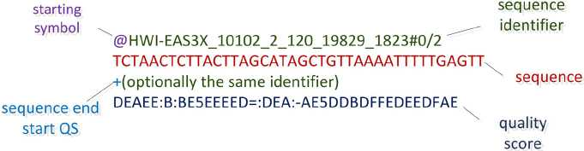
DNA sequencing files
FASTA: 2 lines per read (header + seq)
>ID
AGTCCGGTTGCGTAGTTTTCCGTAGTAAATTTCT
FASTQ: 4 lines per read (header + seq + spacer + quality)
More about this:
P.J. Cock, et al. The Sanger FASTQ file format for sequences with quality scores, and the Solexa/Illumina FASTQ variants. Nucleic Acids Res. Vol. 38,6 (2010).
3
Norwegian University of Life Sciences

Slide 5
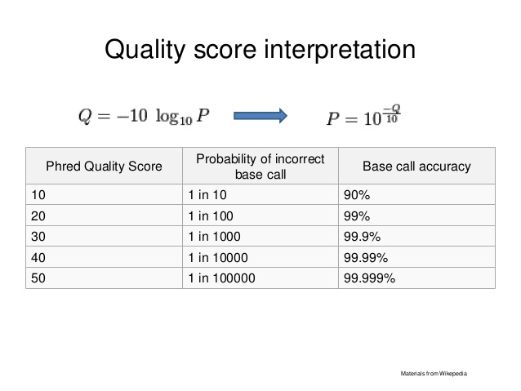
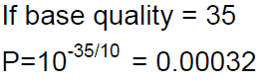
The phred quality score
or 1/3200 incorrect

Slide 6
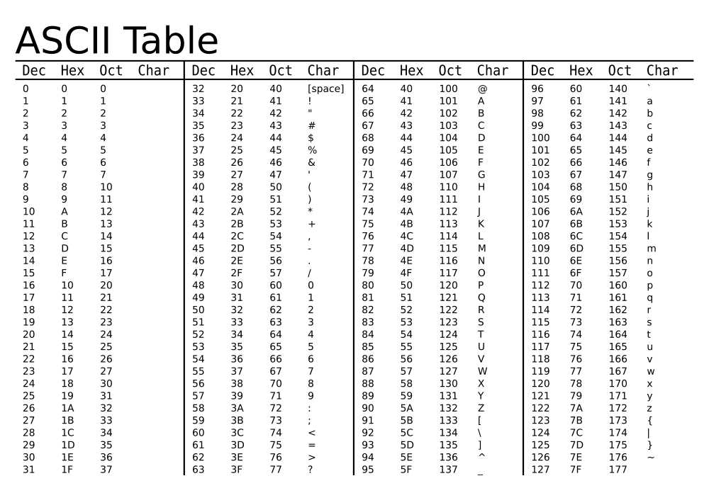
ASCII val
Q value
66
67
-33 -33
___ ___
33 34
> 10^(-33/10)
[1] 0.0005011872 = 1/5000
> 10^(-34/10)
[1] 0.0003981072=1/39000

Slide 7
The phred quality score
or 1/3200 incorrect
More about this:
B. Ewing, et al. Base-Calling of Automated Sequencer Traces Using Phred. I. Accuracy Assessment. Genome Res. 8:175-85 (1998)
B. Ewing & P. Green, Base-Calling of Automated Sequencer Traces Using Phred. II. Error Probabilities. Genome Res. 8:186-94 (1998)

Slide 8
Coverage of sequencing
Definition:
The average number of times any given nucleotide in the original genome has been sequenced
In theory, for one genome:
Assumed uniformity of sequencing
i.e. 30x coverage means the genome has been sequenced 30 times.
4x
2x
GTACGTTTTGCA
GTTTTGCAAACG
Reads
CGTACGTTTTG
AACCCGTACGT
AACGACCG
...AACCCGTACGTTTTGCAAACGACCGT...
Contig
More about this:
D. Sims, et al. Sequencing depth and coverage: key considerations in genomic analyses. Nat Rev Genet 15, 121–132 (2014).
7
Norwegian University of Life Sciences

Slide 9
Sequencing a bacterial genome
How many fragments?
or
How much coverage do we need???
Fragmentation and sequence the fragments
The Poisson distribution!!!!
“The probability that a base is not sequenced is P₀ = e^{-m} ”
m=1 equal 1 x Coverage
P₀ = e⁻¹=0.37 or 37 % of genome not sequenced
What does happen with 5x Coverage?
P₀ = e⁻⁵=0.0067 or 0.67 % of genome not sequenced
And if we have 10x ???
P₀ = e⁻¹⁰=4.539993e-05 or 0.000045 % of genome not sequenced
~99.995 % of the genome complete
100 bp 500 bp
DOI: 10.1126/science.7542800

Slide 10
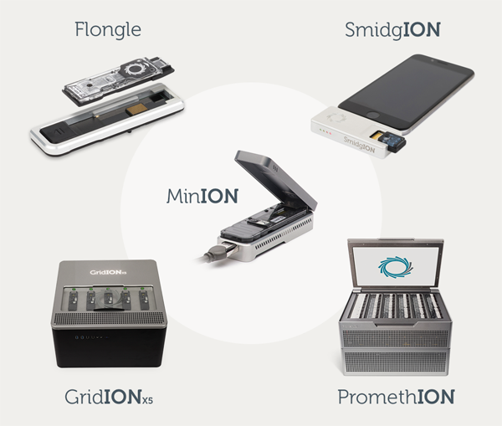
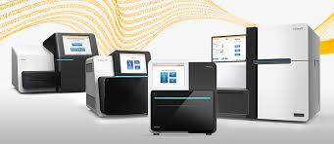
Sequencing a bacterial genome
C=nl/L
C: Coverage
n: number of reads
l: length of the read
L: length of the genome
How many reads with Illumina (~100 bp) to obtain 10x coverage for a 1Mb genome?
How many reads with MiniON (~50 kb) to obtain 10x coverage for a 1Mb genome?
10x=n(100 bp)/1x10⁶
n=10(1x10⁶)/100
n=1x10⁵ reads
10x=n(5x10⁴ bp)/1x10⁶
n=10(1x10⁶)/ 5x10⁴
n=200 reads
Error rate ~ 1%
Error rate ~ 7%

Slide 11
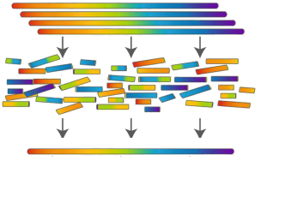
Reads assembly
10
Norwegian University of Life Sciences

Slide 12
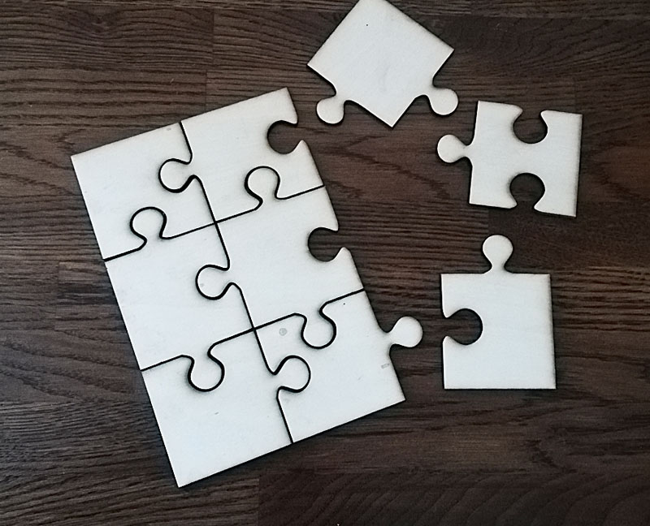
Sequence Assembly
ASSEMBLE the sequencing data into contiguous reads, or CONTIGS
Or in other words:
Resolve a puzzle and reconstruct a long DNA sequence (genome) from smaller fragments
Bigger pieces (longer reads) makes the puzzle easier
Slide by Live H Hagen.

Slide 13
The Assembly recipe:
Find all overlaps between reads
Build a graph (find read connections)
Simplify the graph
Find a sensible path in the graph to generate a consensus
Slide by Live H Hagen.

Slide 14
Assembly - expectation
Genome copies
Reads
Reconstructed genome
Picture adapted from:
Commins, et al. (2009) Biological Procedures Online
13
Norwegian University of Life Sciences

Slide 15
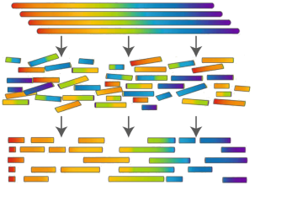
Assembly - Reality
Genome copies
Reads
Contigs
Picture adapted from:
Commins, et al. (2009) Biological Procedures Online
14
Norwegian University of Life Sciences

Slide 16
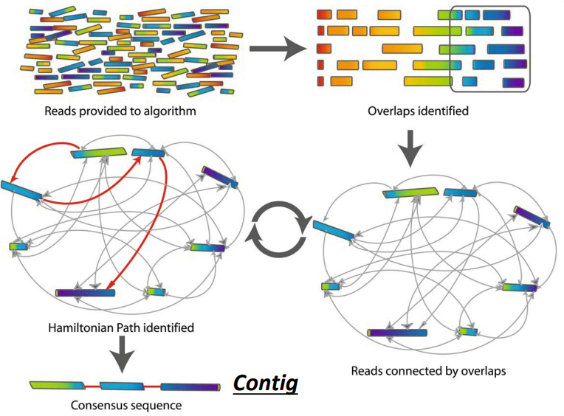
Two main types of assemblers
Overlap graphs (or Overlap-Layout-consensus, OLC)
OLC is composed of three main steps:
Computing the overlaps between the reads (blast-like alignment or k-mer)
Laying out the overlap information on a graph – try to simplify
Generate a consensus from the alignment
De Bruijn assembly:
The (K-1)-mers are the nodes
The prefixes/suffixes are edges
High coverage needed
Execution time depends on the length of the genome (O(G))
Space depends on the k-mer composition
15
Norwegian University of Life Sciences

Slide 17
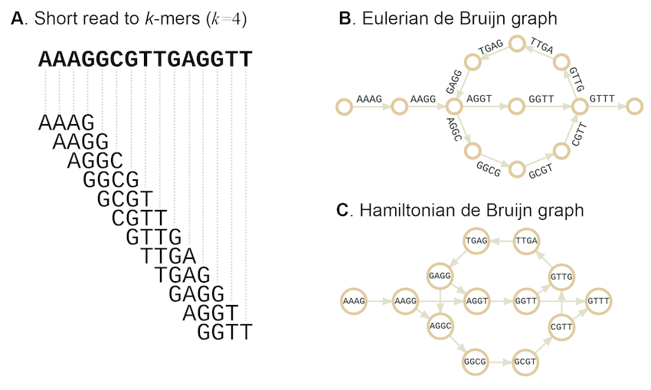
De Bruijn graph and k-mers
Picture adapted from:
Sohn, et al. (2016) Briefings in Bioinformatics
16
Norwegian University of Life Sciences

Slide 18
De Bruijn graphs – simplified
Sequence/read 1
Sequence/read 2
Let’s choose a k-mer of 4
K=4

Slide 19
De Bruijn graphs – simplified
Sequence/read 1
Sequence/read 2
K=4
overlap

Slide 20
De Bruijn graphs – simplified
Sequence/read (a)
Sequence/read (b)
K=4
T
A
T
A
G
A
A
G
GGTT
G
C
overlap
Assemblers usually use
k-mer values > 31
G
T
T
AAAGGCGTTGAGGTT
Contig

Slide 21
Repetitive regions are collapsed
k = k-mer size
l = length of repetitive region
If l > k the repetitive region will be collapsed in the de Bruijn graph
20
Norwegian University of Life Sciences

Slide 22
Is a greater k a solution?
k = k-mer size
l = length of repetitive region
If l > k the repetitive region will be collapsed in the de Bruijn graph
Small k values save space and time, but results in a dense graph and short contigs
Large k values help crossing the repetitions but is constrained by coverage and ultimately the read length
21
Norwegian University of Life Sciences

Slide 23
Assemblers
Canu
Raven
Miniasm/minipolish
Flye
Redbean
Shasta
Unicycler
Overlap-Layout-Consensus (OLC) assembly
Modified/fuzzy de Bruijn assembly / Repeat graph
Alignment of overlapping reads
Hybrid assembly (long reads + short reads)

Slide 24
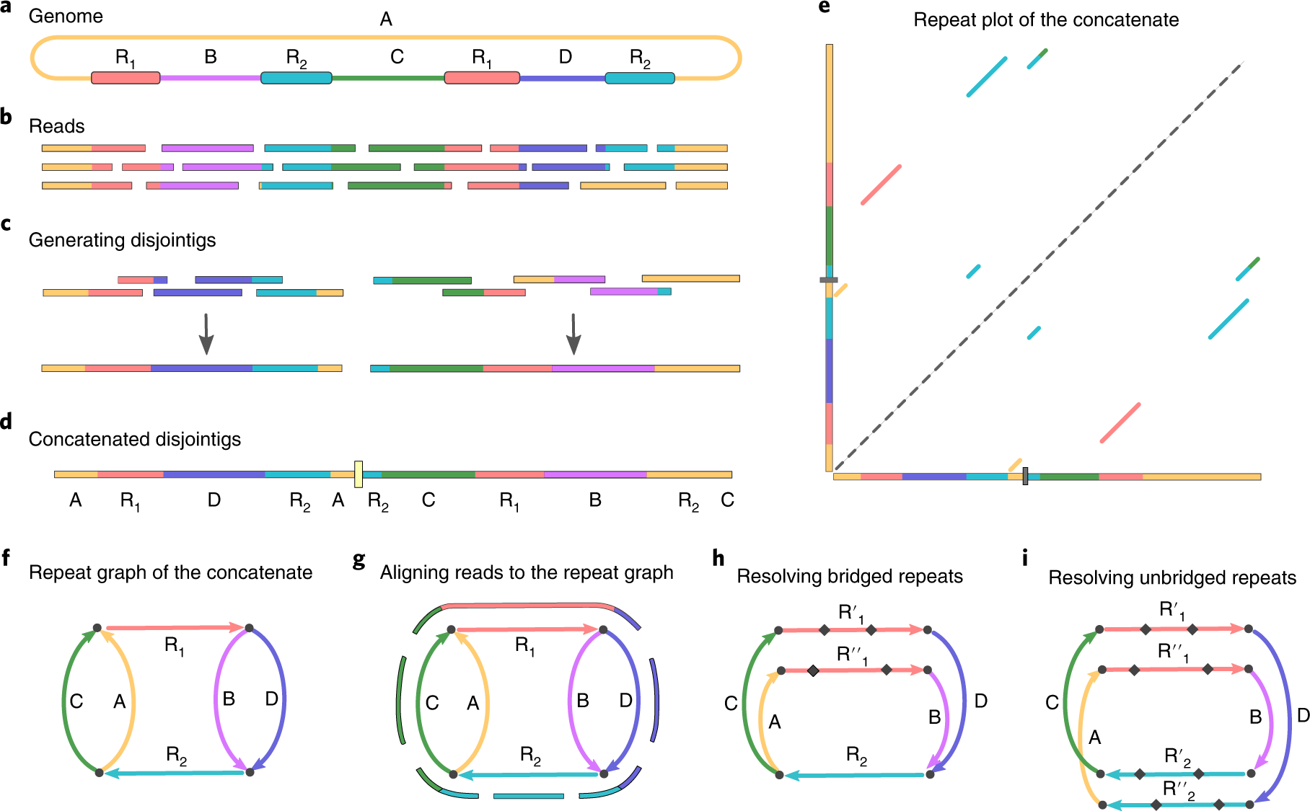
metaFly
de Bruijn graphs relies on exact k-mer matches
But long reads have too many errors!
Solution: Repeat graphs works with approx. matches
Tolerates errors
The Flye pipeline use repeat graphs:
Makes a repeat graph
Aligns the reads to the graph
Resolves the repeats

Slide 25
Key features
Graph-based Assembly:
Efficient Handling of Long Reads
Iterative Assembly Process
High-Performance Algorithm
- Flye uses a minimizer-based indexing to efficiently identify overlaps between long reads, reducing computational load and memory usage

Slide 26
minimizer-based indexing
1. Splitting Sequences into k-mers:For example,
from the sequence ATGCGA, with 𝑘=3
the k-mers are: ATG, TGC, GCG, and CGA.
2. Sliding Window to Find Minimizers:
For each k-mer, a smaller window of size 𝑤 is defined, containing overlapping subsets of k-mers.Within this window, the lexicographically smallest k-mer (or based on a numerical hash function) is chosen as the minimizer.
Lexicographical order is like dictionary order: A < C < G < T.

Slide 27
Sequence:
ATGCGT
k-mer size k=3,
window size W=4k-mers in window:
ATG, TGC, GCG, and CGA
Minimizer for the window: ATG (smallest k-mer in lexicographical order).

